Slide 1
Evaluations
A holistic development approach
Nick D’Errico
USA Hockey Goaltending
Gold-Level Certification Project
Updated May 2024
Notes:
Introduce self
Humans are bad at evaluating others
We’re not designed to do it — Joe Baker
If you’re here, chances are you know there’s trouble with evaluations
We’re often left with more questions than answers at the end
We see the effects at the highest levels — draft picks and selections that don’t pan out, and undrafted stars that emerge from nowhere

Slide 2
Why do this project?
We need to shift the conversation around evaluations.
From “robot goalies” to problem-solving humans
From ranking skill to finding fit
From ”yes/no” to a development opportunity
Notes:
At the youngest levels, our problems have many downstream effects
We miss out on kids who don’t meet our bias, affecting us competitively
We’ve built a culture in North America of telling kids, even at 6 and 7 years old, that they’re not good enough
Shutting kids out stunts development as goalies, athletes, and as humans
We turn people away from our great game
Therefore, I wanted to tackle this project to help us change the conversation around evaluations.
First, our systems focus intently on technique, biasing toward “robots” and “cookie cutter goalies”
Looking at even the NHL, there’s no one right way to play the position
We bias toward what we think “looks right” but don’t consider the unorthodox… or the ability to problem solve
We miss the mental game
How do we gain a full picture of the entire human?
Second, when we rank “best” to ”worst,” we further the culture of shutting kids out
We can’t predict a kid’s ceiling, and even struggle to do that with pros
How can we zoom in on strengths and weaknesses to find fit within our org
Third, how can we make sure the output of our evals helps all goalies grow?
Too often, the conversation starts and ends with “no”
Kids take very little from it besides “I’m not good enough” — and if there is feedback, it often isn’t coachable
If we start building a culture of providing coachable feedback, we will:
Elevate the talent pool
Retain more goalies at the younger levels
Lift up the goaltending community

Slide 3
How?
Core Elements:
Holistic evaluation criteria
  Not just technique & athleticism, but mental qualities too
A rating system
  Showing strengths & areas to build instead of
  “best” & “worst”
Ways to compare & show feedback
  Making evaluations more efficient & providing more insight
The Toolkit
Quick Start Guide
Criteria Cheat Sheet
Full Manual
Evaluation Tools
Feedback Template
Link at the end!
Notes:
This presentation is a very brief glimpse into a much more extensive toolkit built for this project.
You’ll get a QR code to my website at the end with everything included.
There’s so much more to cover beyond this presentation, so I invite you to come and chat to dive in deeper and even try out the system with some game video.
For the sake of time, today I’ll cover the core elements:
Holistic criteria — going beyond technique toward a full picture of the goalie
A rating system that reframes strengths and weaknesses, and which helps build consistency
And a way to use these ratings as a means of comparison and of generating feedback

Slide 4
Holistic Criteria
Notes:
To start, let’s explore this idea of “holistic.”
No, it’s not candles and herbs, although good on you if you do that.

Slide 5
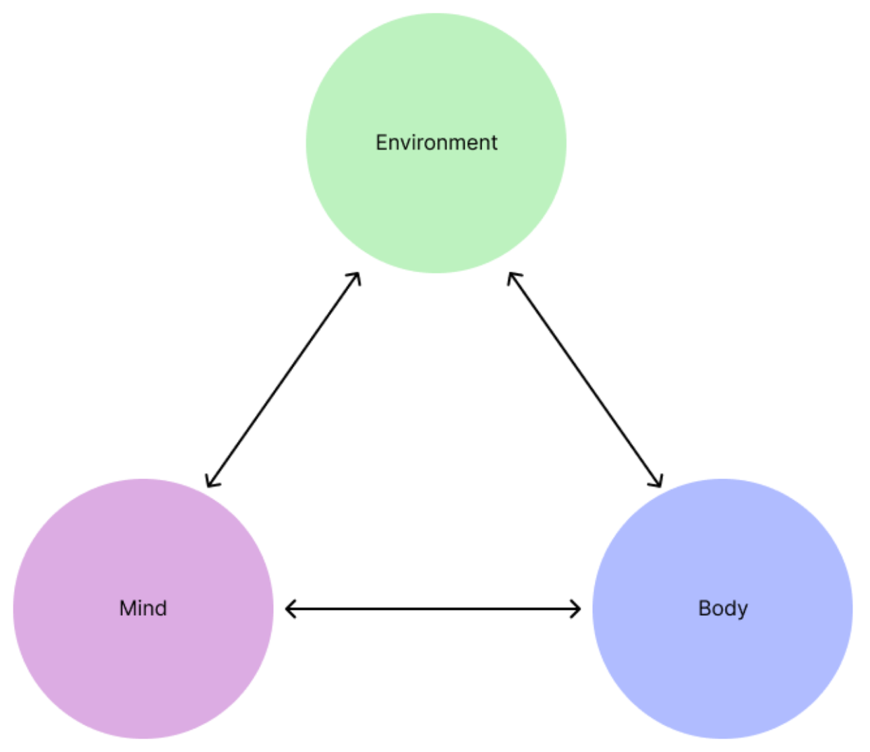
Notes:
The idea of holistic includes three things:
Mind
Body
Environment
Your mind obviously allows you to think, understand, decide, process, etc. We’re not worker bees with a hivemind; we think for ourselves.
Likewise, our body allows us to act, to interact, to communicate, and to have an effect on our environment.
And then our environment is what ultimately gives life meaning. As things change around us, we have a reason to want to act. We have things in our environment that we feel and things we need to do.

Slide 6
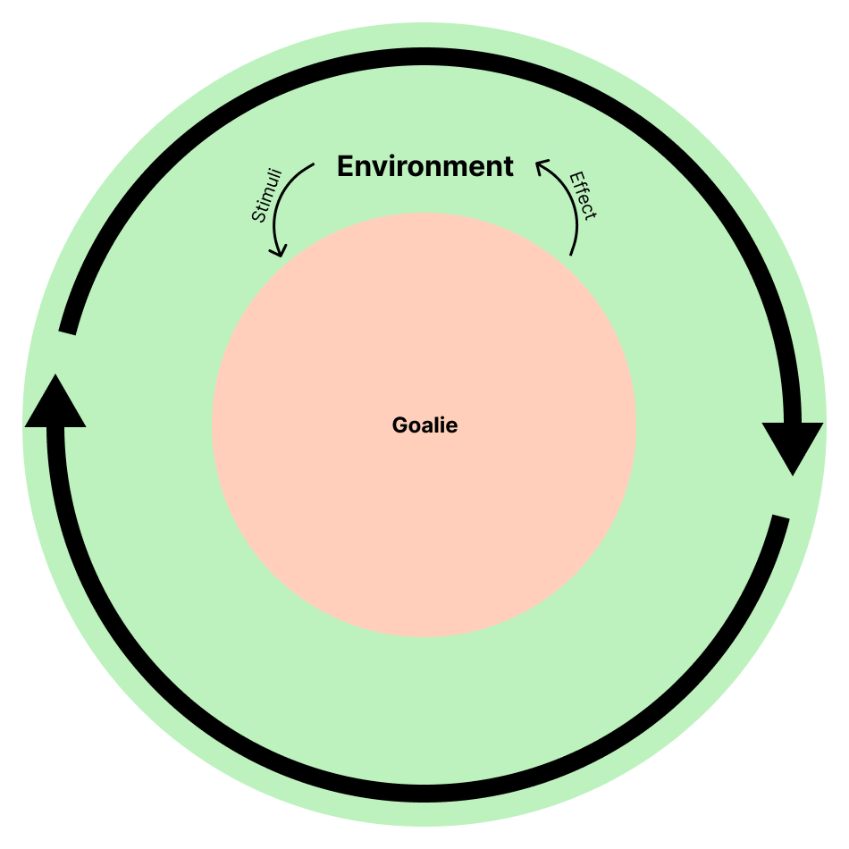
Notes:
So how does this apply to goaltending? Well, let’s think of a goalie in their natural environment, like a game.
The game gives us a signal, like the fact that a shot is coming.
As a goalie, we make a save and put the rebound in the corner.
We’ve now changed the environment, which makes the players chase the puck, which makes us move back on angle, changes the play, and the whole cycle repeats.

Slide 7
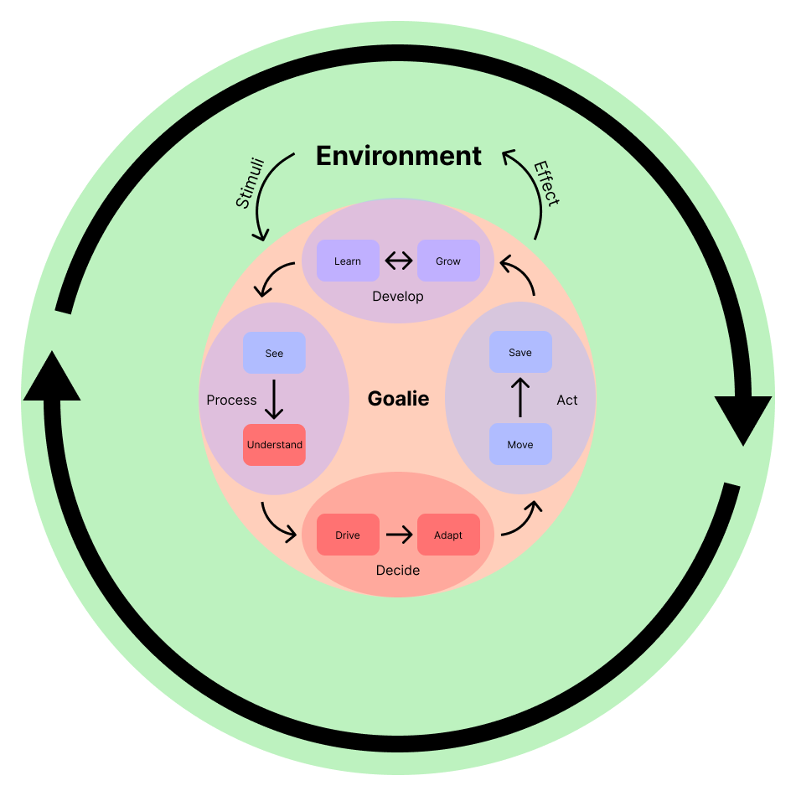
Notes:
We can break this down even further.
There’s a lot more depth to the cycle, but at its most fundamental level, a goalie has to:
Process that a shot is indeed coming
Decide on a course of action
Actually act and make a save
These three steps are what take a signal from the environment to us affecting the environment.
But as the cycle repeats over and over, we get this fourth stage, where repetition helps us develop our skills and become more effective as goalies.

Slide 8
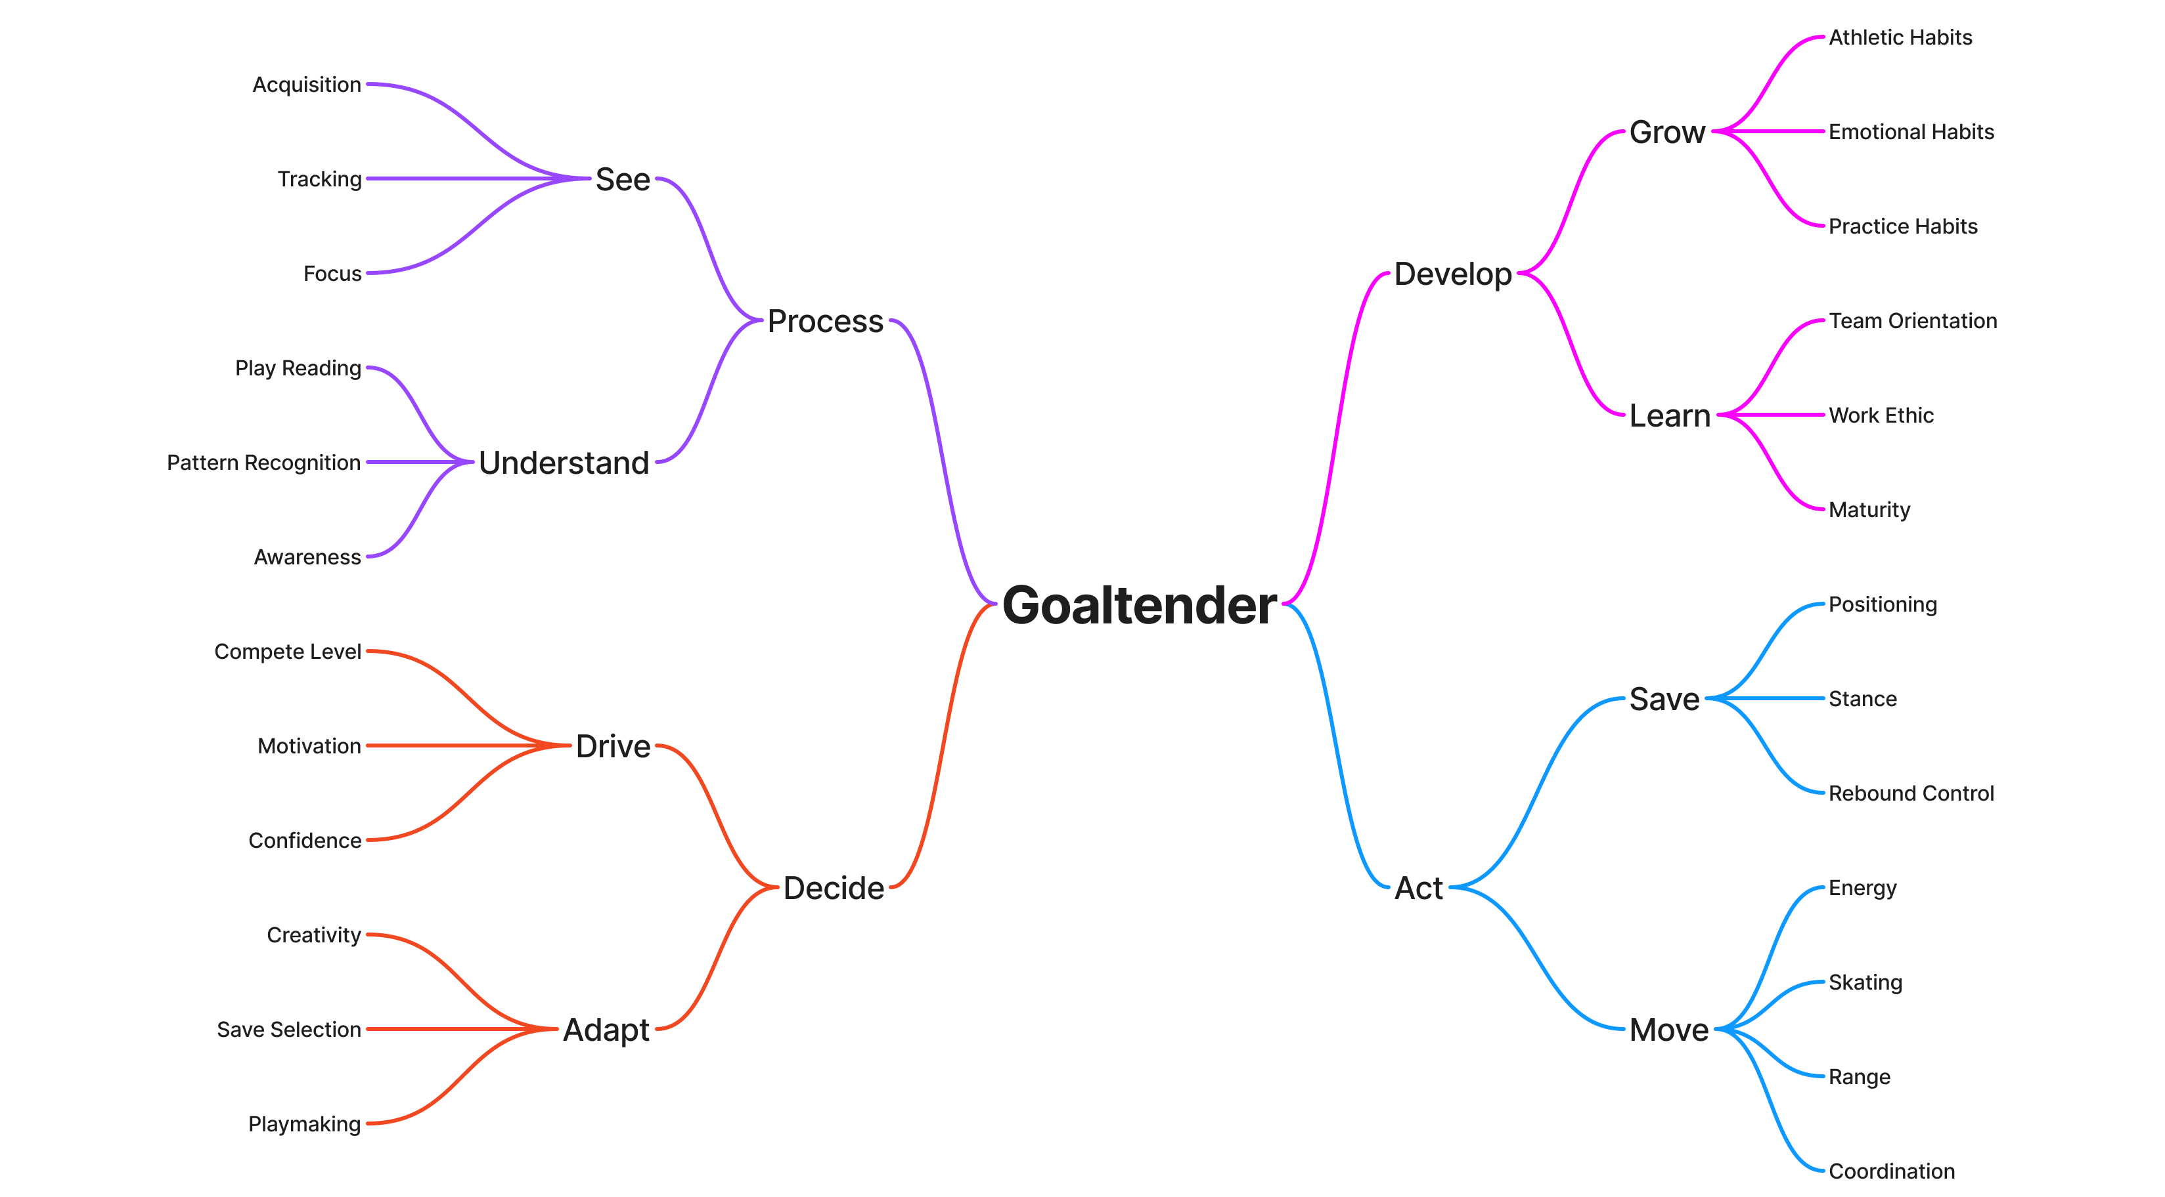
Notes:
This cycle then translates to this map, which is the exhaustive list of criteria in the system.
For the sake of time, I won’t delve back into each one, but you can access both long-form definitions and a quick cheat sheet within the toolkit at the end.
Instead, a few key points:
This is simplified intentionally, and you’ll notice that these are categories that may cross over one another.
Initially, I had mindmaps around 5 levels deep with hundreds of criteria to try and gain an exhaustive picture.
But there are challenges with depth to that level:
Making sure that it was understandable for all levels of evaluator and organization, especially with categories
Making sure that what came out of this was coachable
Say we watch a goalie struggle on the post. In a system that details out “post play,” the output of that might be “needs to work more on post.” But what does that mean? How is that valuable?
The root cause could stem from plenty of broader issues. Perhaps it’s balance which is a factor of stance. Maybe it’s integration, which is part of skating and movement. Or maybe it’s appropriateness of RVH use, which comes down to play reading?
When we get prescriptive and dissect skill, we often miss things. It’s valid to say “struggles on post” within a comment. But when it comes to making things useful, it helps to look at the broader tool.
Put another way… you have Phillips head and flathead screwdrivers. But if you’re hammering in a nail with the handle, the problem isn’t the type of screwdriver, but your understanding of how tools work.
One more point…

Slide 9
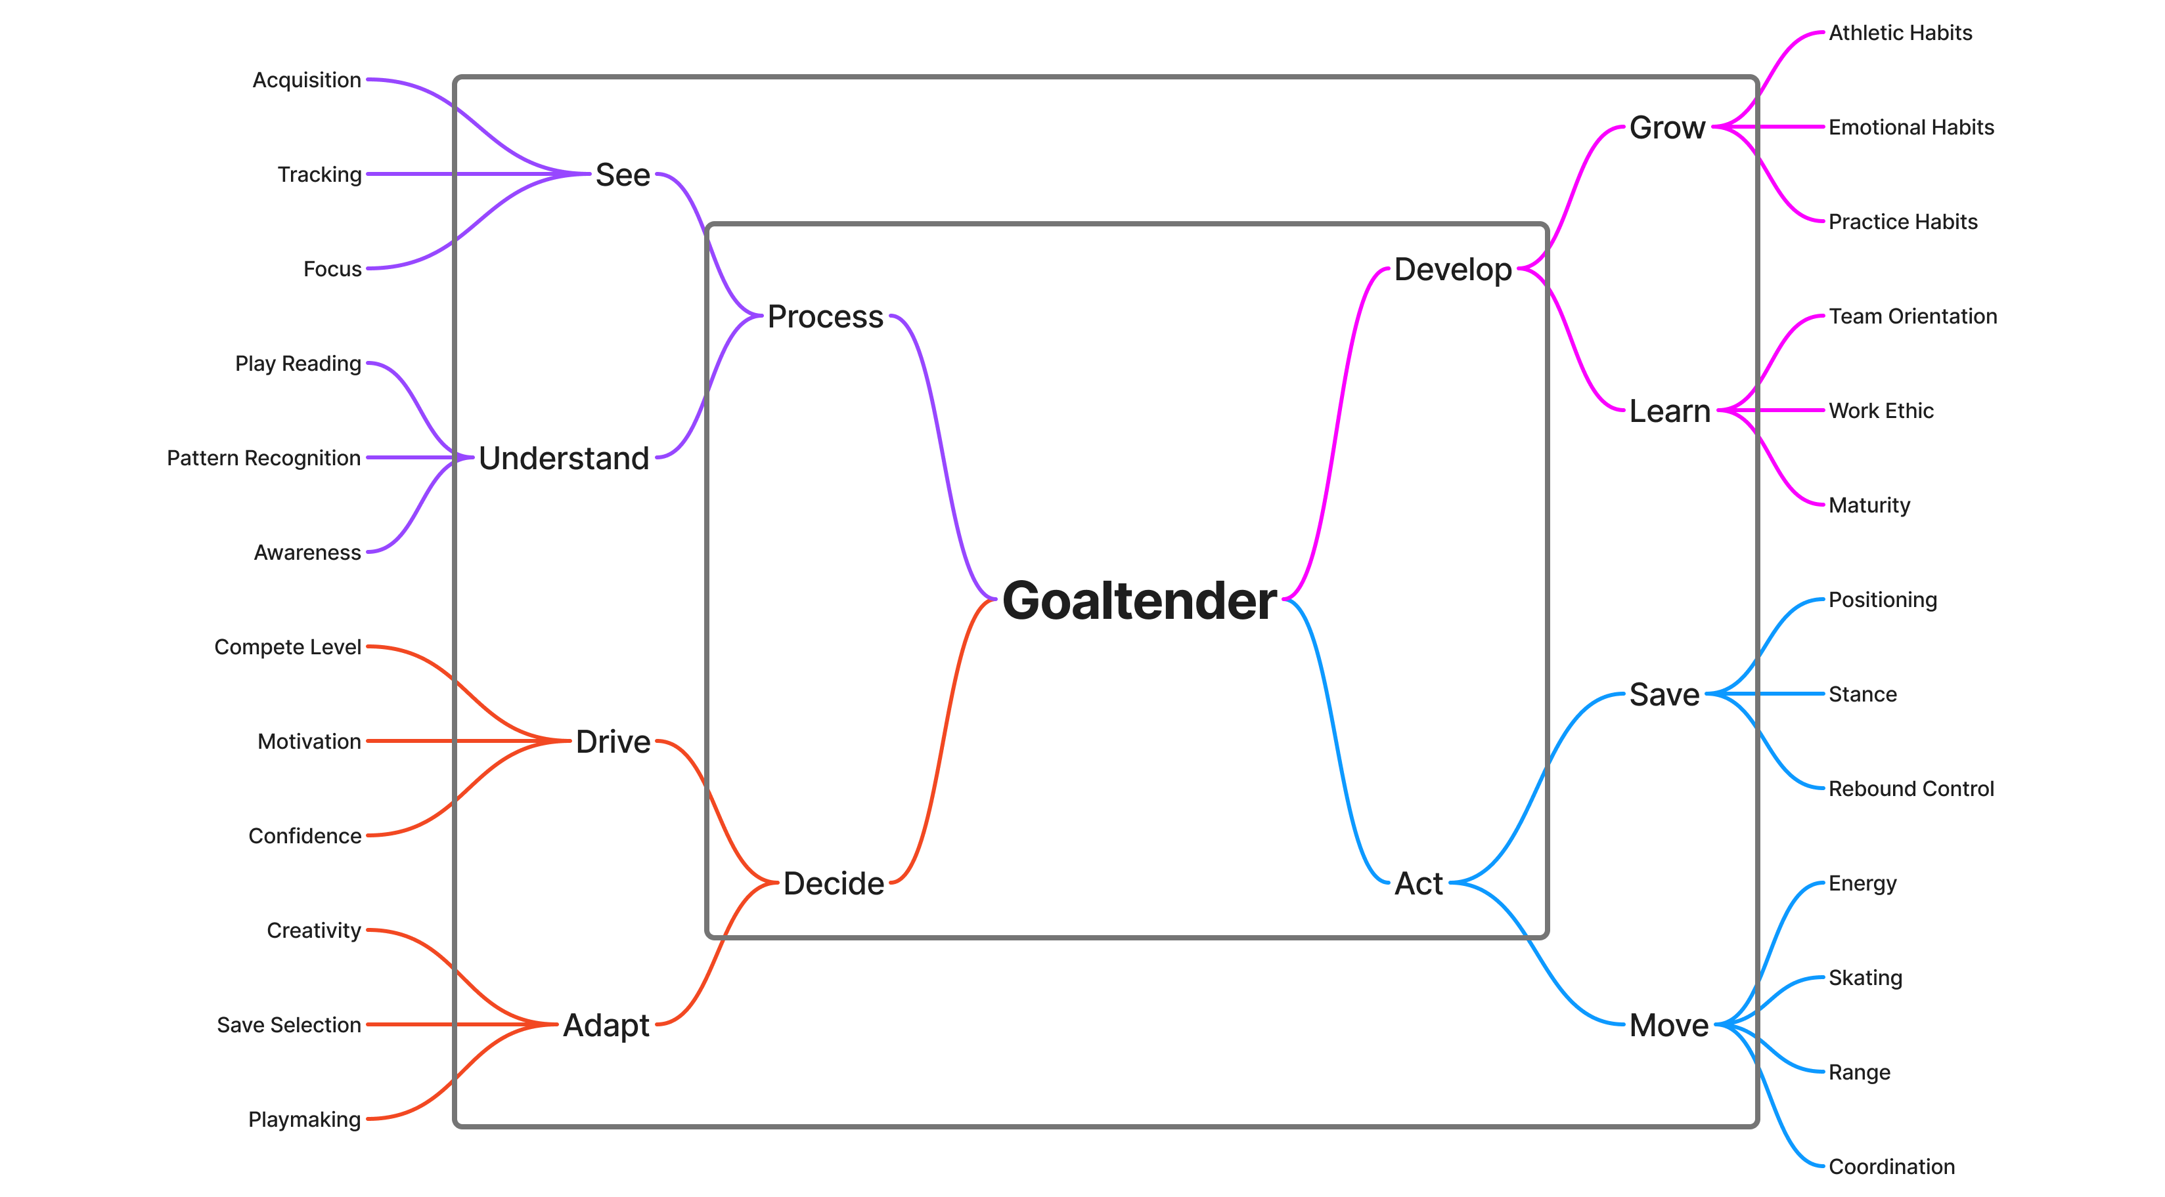
Notes:
The structure here leaves room to simplify when necessary
Say your organization lacks a goalie expert. Don’t understand much about stance? Back out a layer and look more broadly at their ability to make a save.
Similarly, say you’re evaluating 25 goalies at a regional camp. At a glance, we should be able to get a quick understanding of everything within the first layer and then dive deeper if more time becomes available.

Slide 10
Ratings
Notes:
This criteria is great and all, but how do we actually measure it now?
Initially, I thought that opinion and subjectivity was the problem because it seems to be the source of bias.
We look toward analytics because we find comfort in certainty.
Steve — “nothing beats the sniff test” — effectiveness
While analytics can still be important to answer “is this goalie good?”… “Do they positively affect their environment?” … they don’t necessarily tell us why.
That’s why, in this process, I found that we need to embrace the subjectivity, too.
Evaluations are human observations, which are inherently subjective.

Slide 11
Shifting Perspective
Rate only based on what’s in front of us.
  This goalie
  With these players
  In this game, drill, practice, season, etc.
“Laddered” development → Are they ready to move up?
Notes:
Rather, the problem is consistency as different evaluators look at different goalies at completely different times.
When we compare against our idea of a “best” goalie or a peer group, we’re relying on memory which, no matter how good you are, loses detail quickly.
How do we ensure that different looks at the same goalie give us a consistent view of strengths and weaknesses?
As we evaluate, instead of comparing against goalies who are across the ice or who are not even in the building, let’s just rate what’s in front of us, right here, right now.
This (or these) goalie(s)
With these players
In this competition
As we observe, let’s think about laddered development.
Is this goalie competing well at this level and pace? If they’re struggling and the level of competition is below ours, are they really ready to move up? If they’re competing above, then should we re-view them within a higher level of competition?
And, most importantly, why are they above, below, or meeting this level of competition?

Slide 12
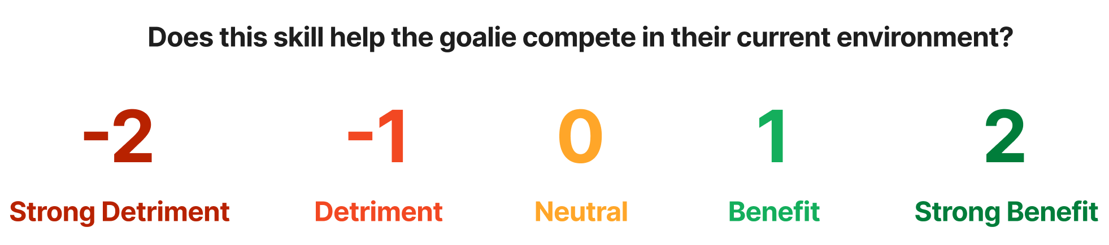
The Numbers
Rate effectiveness.
  How do they compete?
  How do they contribute to the team?
  Do they support their own development?
Notes:
To get to that why, we’re trying to understand what skills are effectively contributing to their competitive ability, or which are holding them back. To do that, we use this 5-point scale with what I call a “baseline.”
Some of you may recognize the wording underneath as something you’ve seen before in surveys.
As we observe a goalie, whether that’s in a game or over the course of a season, the root causes of problems or success inevitably stick out.
As we start to notice them, we can rank these criteria as detrimental or beneficial to their ability to compete.
And as we notice these root causes becoming more consistent, then we move them outward into these ”strong” categories. That’s in essence how we pick out strengths and weaknesses, both for development and for finding fit.
Of course we often think of competing as being on the ice.
But as a coach, you’re also looking at their contribution to the team dynamic, and of course their ability to help themselves.
Now, here’s the caveat. For those traits that don’t stick out, we have this idea of a “baseline” or neutral — where the middle is neither beneficial or detrimental, but appropriate, for the level of competition.
Put another way, traits that are “neutral” are non-factors in the goalie’s ability to compete.

Slide 13
Watch the game
Rate only what sticks out.
  Non-factors → Score as 0
  Can’t reasonably assess → Leave it blank
  When we rate what we can’t see, we’re not helping anyone.
Notes:
In many eval systems today, there’s the expectation that we have to rate every single box. But when we spend time dissecting skill and staring at the eval sheet, we end up missing what’s on the ice.
Therefore, with this system, we don’t need to rate everything — only what sticks out.
As we said, if you don’t believe a skill has factored into success or failure, or you’re unsure, rate it at zero.
Likewise, if the evaluation isn’t appropriate for a certain skill — say, looking for playmaking ability during a shootout competition — then leave the skill blank.
When we rate what we can’t see, we’re generating inaccurate results that skew both selections and feedback.
Instead, use another look, or different types of looks, to make sure you can reasonably assess all of a goalie’s skillset. My manual in the toolkit shows some options based on the specific criteria you’re looking for.

Slide 14
Comparisons & Feedback
Notes:
So with the criteria and numbers in mind, how do we actually turn them into actionable insight?

Slide 15
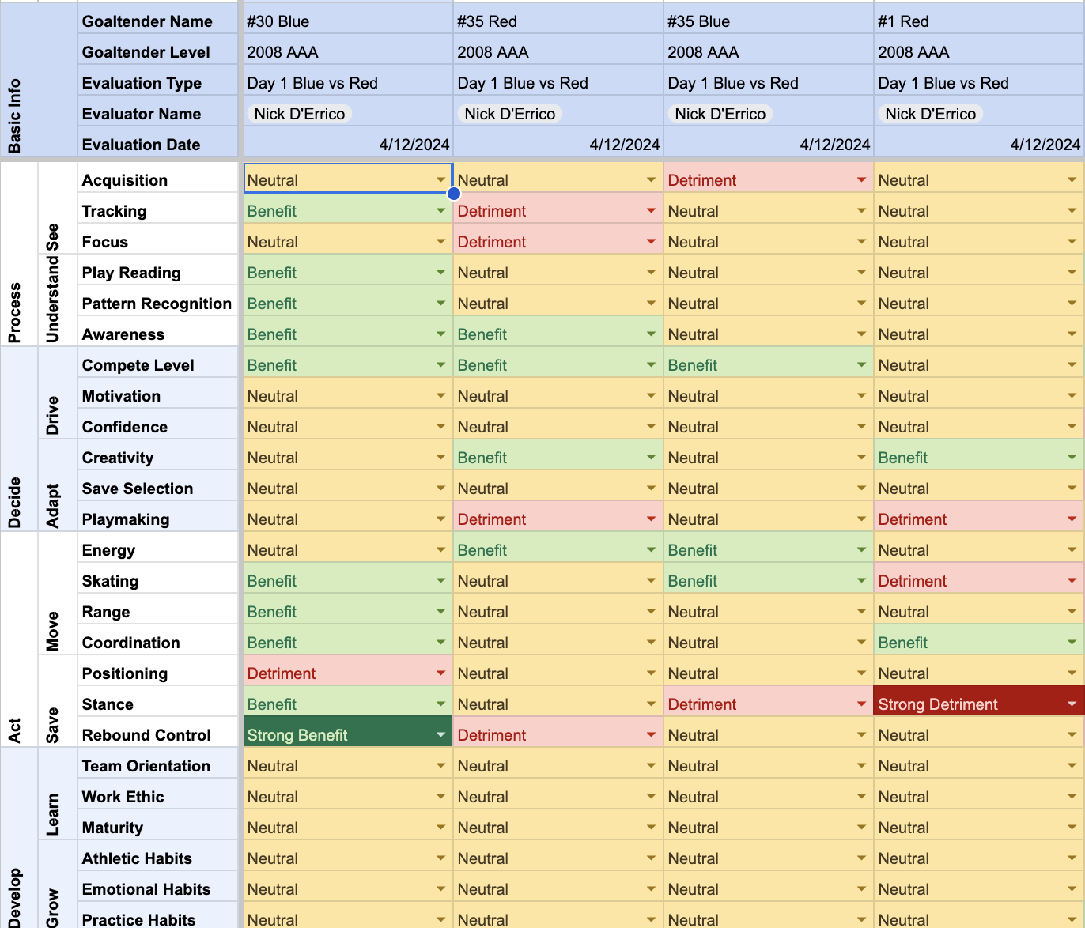
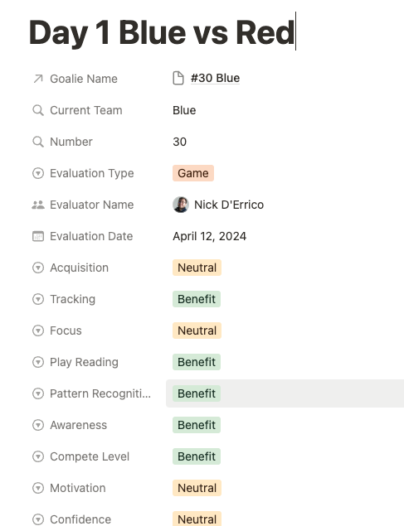
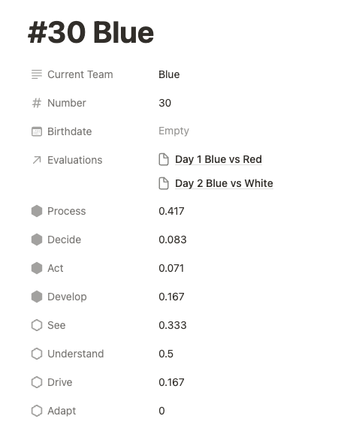
Using the tools
 |  | Process |  | Decide |  | Act |  | Develop |  | Master Categories
Goalie Level | Goalie Name | See | Understand | Drive | Adapt | Move | Save | Learn | Grow | Process | Decide | Act | Develop
2008 AAA | #1 Red | 0.50 | 0.00 | 0.17 | 0.33 | 0.25 | -0.50 | 0.33 | 0.00 | 0.25 | 0.25 | -0.07 | 0.17
2008 AAA | #30 Blue | 0.67 | 0.83 | 0.33 | 0.17 | 0.50 | 0.83 | 0.17 | 0.00 | 0.75 | 0.25 | 0.64 | 0.08
2008 AAA | #33 Gold | 1.00 | 1.00 | 1.67 | 1.00 | 1.25 | 0.00 | 1.33 | 0.67 | 1.00 | 1.33 | 0.71 | 1.00
2008 AAA | #33 White | 0.00 | 0.33 | 0.00 | 0.00 | -0.25 | -1.00 | 0.00 | 0.33 | 0.17 | 0.00 | -0.57 | 0.17
Notes:
To briefly touch on the toolkit, I’ve provided several ways to enter each eval’s scores and then get averages.
These averages directionally tell you where a goalie’s strengths and weaknesses lie.
And of course, the more quality looks you get, your outlooks become more accurate. We all know that goalies, and especially kids, can have good days and bad days on the ice.
What all these numbers also lead to are…

Slide 16
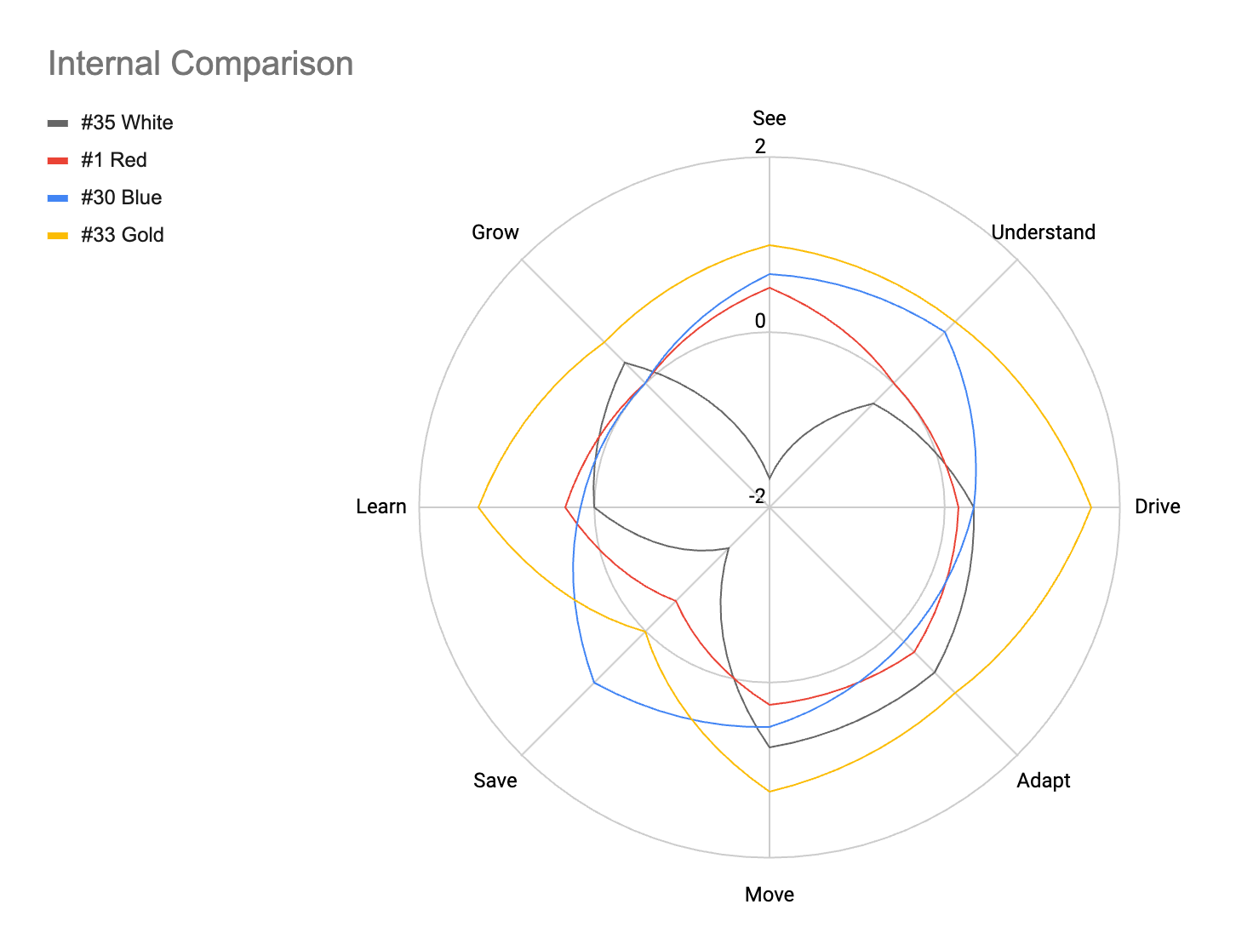
Comparing Goalies
Notes:
Visualizations like this.
The powerful thing about visualizations are that they provide us a way to directly compare goalies by overlaying their charts,
and to understand strengths and weaknesses without fixating on the numbers.
How are a goalie’s strengths and weaknesses compared to others?
Who excels beyond the baseline of zero, and where? What’s holding a goalie back from playing at a higher level?
Additionally, when making selections, they provide a way for us to frame why a goalie is or is not a good selection for our organization
Why do they provide us that ability?

Slide 17
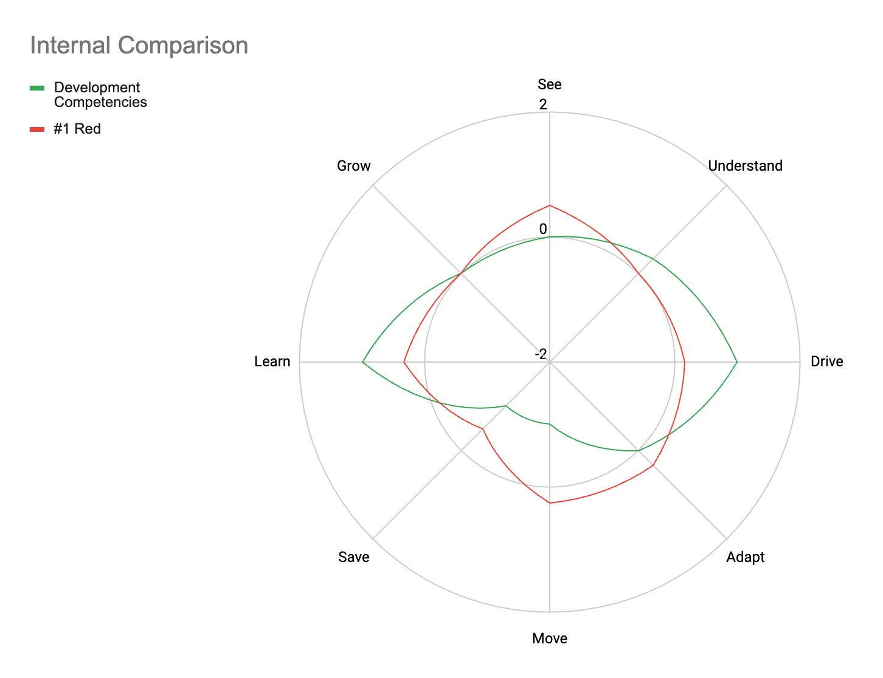
Finding Fit
Rate yourself.
  What kinds of goalie skills does our team system need?
  What are we able to help develop in a goalie?
  Rate clear needs as positive
  Rate skills you can develop as negative
Be realistic. You have strengths and weaknesses too.
Notes:
Because we can come up with a chart for our organization and find goalies who have the best potential fit.
How do you do this?
As a team or organization, rate yourself.
Consider what your team and organization needs
And also how your organization may be able to help a goalie grow
It’s counterintuitive, but…
As you look at these, rate the things you need positively
And the things you don’t need so much, or what you can develop, negatively
And of course, be realistic. Your org has strengths and weaknesses, and you’re not necessarily excelling everywhere.
Similarly, if you’ve evaluated a goalie and they’re excelling everywhere, be prepared for them to get better offers than what your team can provide.
Shoot for those who excel, but realistically look for the best fit.

Slide 18
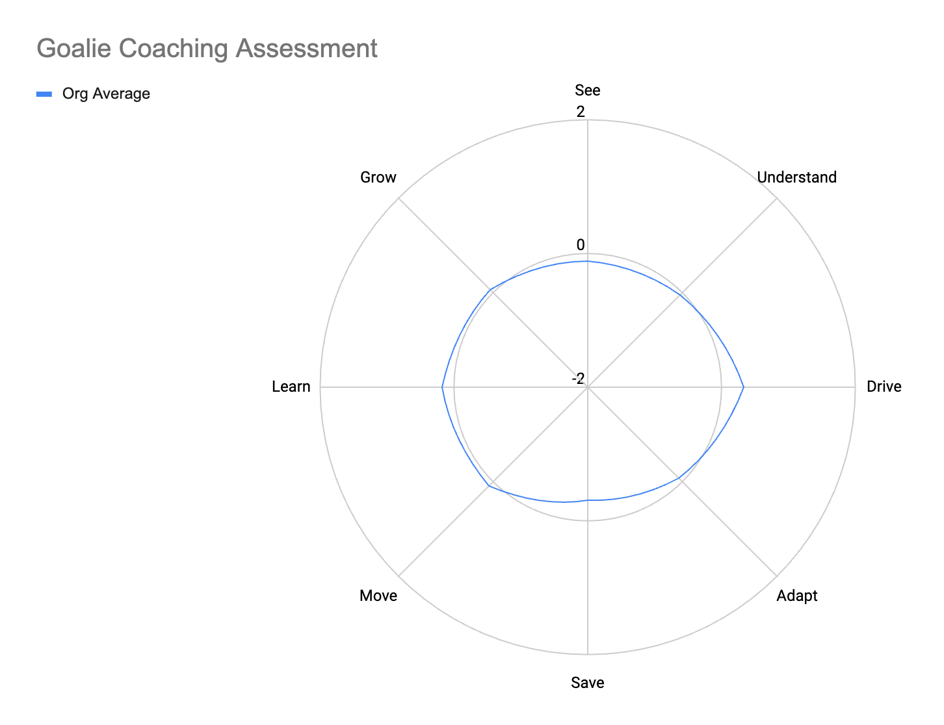
SELF-ASSESSMENT
Notes:
Another interesting use case here is to use this to rate yourself. If you’re evaluating your own goalies, take a look at your overall averages. This can actually be a great way to show what you need to work on as a coach, and what your organization’s competencies are.

Slide 19
Sharing Feedback
Notes:
So what does this all look like as feedback?
For one, show the chart, but remove the numbers.
Perfectionists can fixate on the numbers
What matters is proportion and understanding where you excel, and where work is needed
In this sense, “well rounded” is quite literal — you want to be able to compete with every skill while still having strong points to your game
The other critical piece… you likely already have notes from your evals
Take 5 minutes and string them together, or 10 minutes and clean them up a bit more
In providing this feedback, the most disheartening thing I heard is that barely anyone had received this kind of feedback, ever.
This feedback is how we kickstart self-awareness and self-analysis. The kids just need guidance.
This is how we elevate the goaltending community. Even if this goalie isn’t right for you today, you’ve given them the insight they need to work hard and show you they can be your goalie tomorrow.

Slide 20
The Takeaways
Notes:
There’s so much detail to this project that you’ll find in the toolkit, but I want to close with a recap.

Slide 21
The Takeaways
This is a framework to shift the conversation.
Take as much or as little as you need, but remember:
View problem-solving humans in this environment
Find fit with strengths and areas to develop
Create development opportunities to elevate goaltending
I invite you to continue the conversation.
We need your perspective.
Notes:
With this project, we set out to shift the evaluation conversation.
As you go back and do your own evals, you’ll find what works for you.
The wonderful thing is that this is all scalable, so take what you need. But also remember the core points:
We’re looking holistically at the goalie, both mind and body, and how they compete within their current environment
Use memory as little as possible — stay focused on what’s in front of you
Shift focus from “best” to “worst” and instead look for fit using their strengths and weaknesses
Finally, take the extra 5 minutes and give these kids the kickstart they need.
The tools in the toolkit make it as easy as copy & paste
The level of competition, and goaltending as a whole, will benefit
I encourage anyone to take this system further and continue development, as I’ll be doing too. And I welcome your feedback.
Goaltending needs more voices who are generating ideas.

Slide 22
Acknowledgements
A special thank you to Justin Goldman, Steve Thompson, Maria Mountain, Euan King, Hannu Nykvist, Thomas Magnusson, Mike Buckley, Jared Waimon, Brian Eklund, Nate Speidel, Chuck Thuss, Stephanie Yates, Lou Jaros, Anthony Shrum, Elite Prospects, the students and staff of the USAH Goaltending Gold class, and the Central Mass Revolution.
This project is dedicated to:
Collette and Damien D’Errico, for their unwavering love, patience, and support as I follow this path. I love you both so much.
The goalies of the Central Mass Revolution, who give me purpose, fulfillment , and joy as a coach.
And to Doc D’Errico, from whom I inherited a passion to teach and to improve the lives of youth. I miss you every day, Dad.
Notes:
This project would not have been possible without all the folks listed here, many of whom were interviewees who helped shape the model. A massive thank you to all.

Slide 23
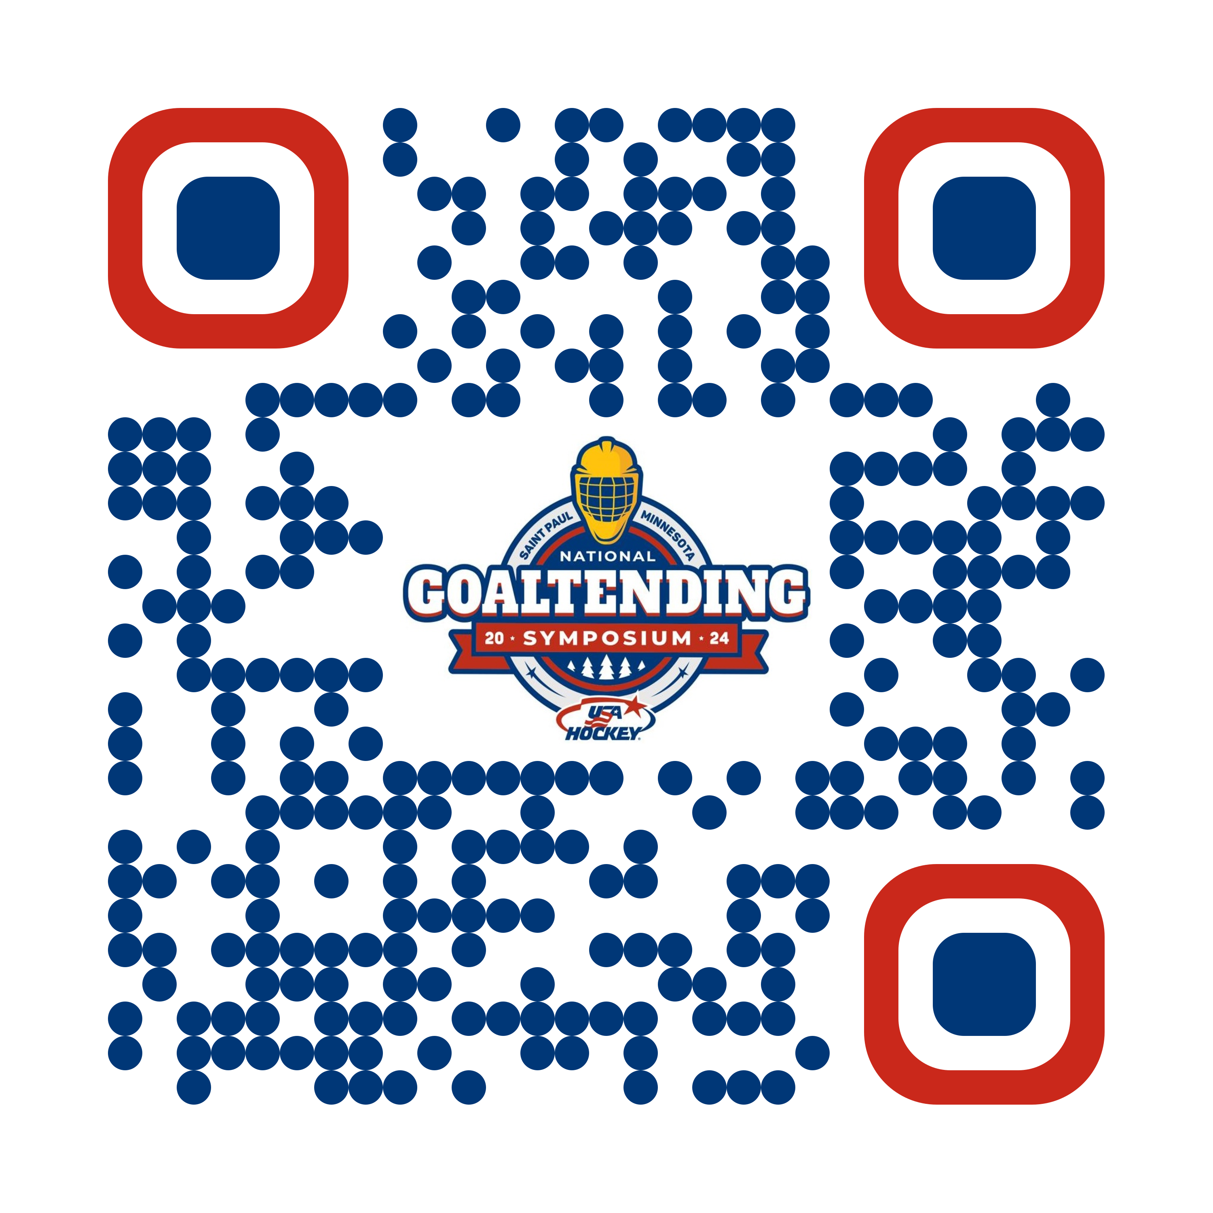
Resources
Nick D’Errico
Goaltending Director, Central Mass Revolution
Goaltending Team, Mass Hockey
nicholasjderrico@gmail.com
Notes:
Please grab the QR code here, which will take you to my website built with an app called Notion. You can read, explore, and then come find me at booth #111, or if you miss me for some reason then please reach out via email. I’m always open to chat.

Slide 24
Thank you
Notes:
Thank you everyone for your time and receptiveness. You’re welcome to grill me for as much time as we have left.

